Slide 1
Serverspec in cloud provision
Serguei Kouzmine kouzmine_serguei@yahoo.com

Slide 2
Serverspec in cloud provision
Successful operation automation usually needs, along with core tool technical skills some curiosity and knowledge about the system under test - not strictly but is recommended. For example, (no)SQL, Angular/MQ experience would be a great help in web testing, HTML / Javascript no longer sufficient .
Often more critical than provision engine (Puppet, Chef, Ansible, DSC learning curve.
In a similar case, an QA engineer fluent in Selenium Appium or Katalon often is or eager to grow Web developer skills but unlikely ever interested in the code base of those tools.

Slide 3
Terminology: what is *spec
RSpec - popular framework for Behavior Driven Development (BDD), from Rails time frame. BDD is a way of writing unit tests in a original DSL that reads like plain English phrases describing the expectations the software product is to satisfy taken from some stakeholders meeting minutes but at the same being a valid Ruby code can be automated and if/when fail, produce reasnably intelligent error messages. The application under test is not modified - it is RSpec job is to have it called the desired way.
Puppet/Chef uses a similar frameworks to let module or profile developer compose assertions about their provision scenarios (a.k.a. catalogs) to e.g. have specific resources being declared in desired ways. Later, Puppet infrastructure guarantees the results of the real provision will match the spec.
When Puppet-RSpec gem and process step that constitutes certain lint checks to ensure the Puppet code follows the Puppet style guide. In Chef, comes under the name of foodcritic gem / app. Both features some look and feel of Rspec: matchers and chains
expect(some_subject) to do_verb.with_noun
expect { should verb_noun('identifier') }.to raise_error(_,
/no way/)
Other then using distinct trademark RSpec semantics Serverspec is just a soundalike tool which translates acceptance criteria simply into core OS and software feature probes.

Slide 4
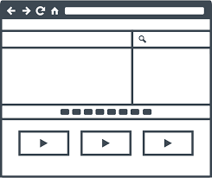
IaaS to PaaS mutation challenge

Slide 5
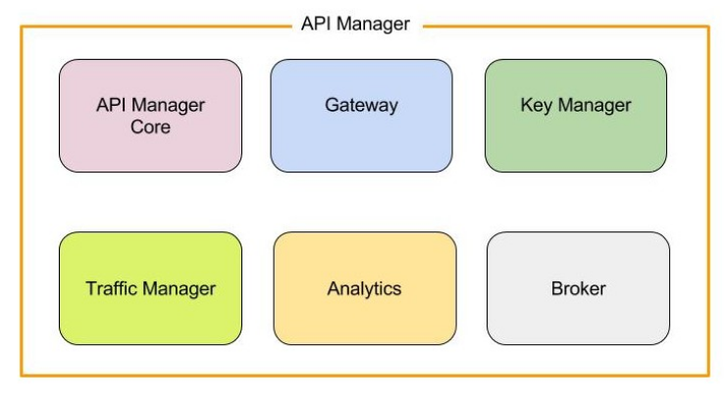
IaaS to PaaS mutation challenge
Cloud architect envisions building a platform for some integrated enterprise modern application stack using WSO/2 API Manager facilities to create, publish, manage, version, control access, throttle and monetize the APIs.

Slide 6
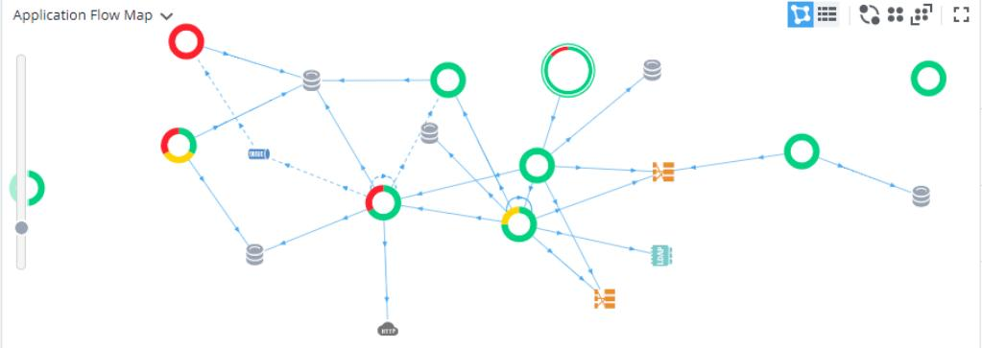
IaaS to PaaS mutation challenge
Cloud cluster will be provisioned by Puppet
https://wso2.com/

Slide 7
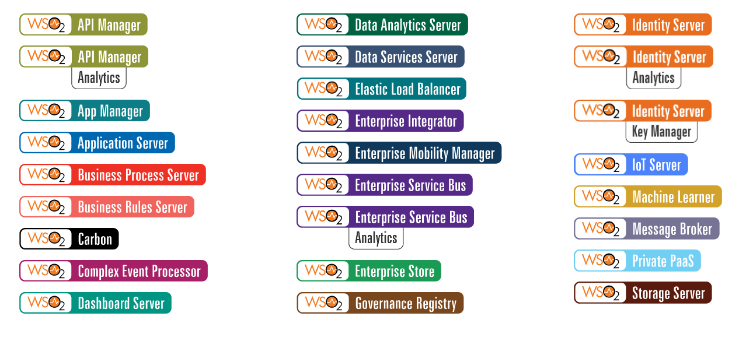
IaaS to PaaS mutation challenge
https://wso2.com/

Slide 8

IaaS to PaaS mutation challenge
Platform will offer to mobile and web customers the existing and future API

Slide 9
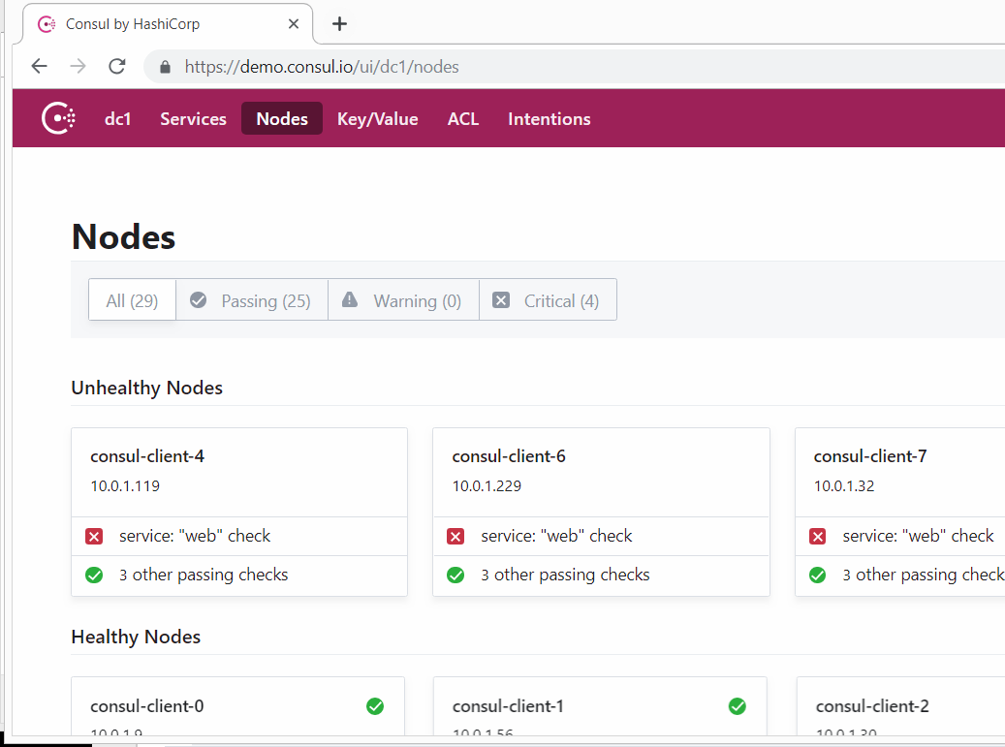
IaaS to PaaS mutation challenge
org.springframework.cloud.client.discovery
public interface DiscoveryClient
DiscoveryClient represents read operations
commonly available to
Discovery service such as
Netflix Eureka or consul.io

Slide 10

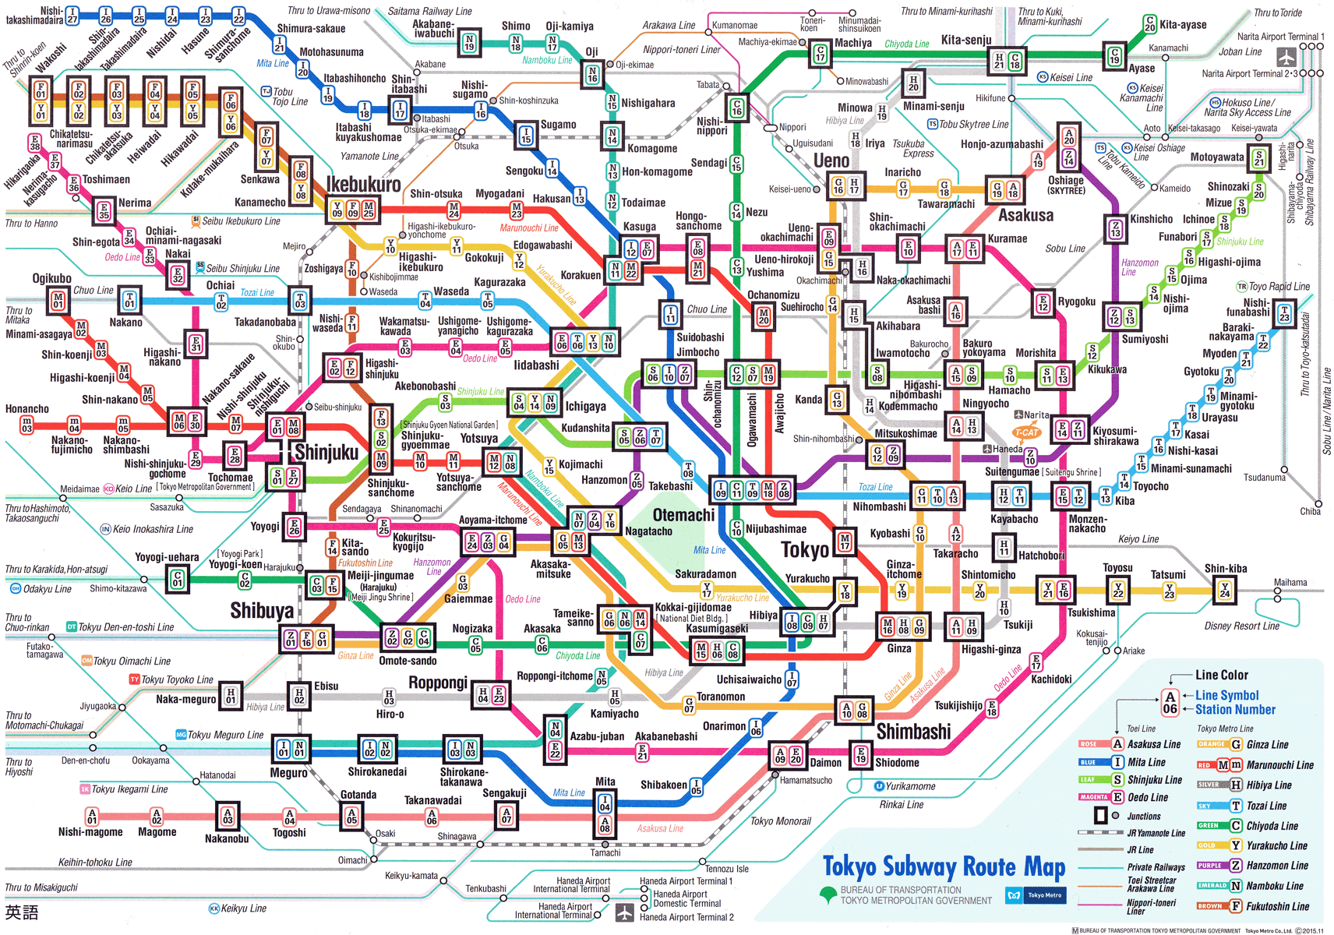
IaaS to PaaS mutation challenge
Puppet strengths
Control repository and r10k effectively manage environments through git braches
Hiera separate parameters from the manifests with easy parameter override
Puppet operates system information and module specific facts to
compile and apply the catalog

Slide 11
Granular Configuration Management Example
Fragment of the real systemd service unit file /etc/systemd/system/gateway.service
[Unit]
Description=service
Requires=some prereq.service
After=another.service
[Service]
User=appuser
Environment=JAVA_HOME=/opt/jvm/java
Environment='JAVA_OPTS=-Dcom.mycompany.package.App.app=/home/appuser/.app -javaagent:/opt/appdynamics/appserveragent/javaagent.jar,EXTRA_JARS
=/opt/appdynamics/additional.jar’
ExecStart=...
ExecStartPre=...
[Install]
WantedBy=multi-user.target

Slide 12
Granular Configuration Management Example
Fragment of the real apache configuration fragment hieradata/template configuration example of templates/vhost/_security.erb
<% if @_modsec_disable_ids.is_a?(Hash) -%>
<% @_modsec_disable_ids.each do |location,rules| -%>
<LocationMatch <%= location %>>
<% Array(rules).each do |rule| -%>
SecRuleRemoveById <%= rule %>
<% end -%>
</LocationMatch>
<% end -%>
https://github.com/puppetlabs/puppetlabs-apache/blob/master/templates/vhost/_security.erb

Slide 13
Granular Configuration Management Example (2)
Fragment of the real apache module manifest dealing with security configuration manifests/vhost.pp
992 # Template uses:
993 # ...
994 # - $modsec_disable_ids
995 if $modsec_disable_ids {
996 concat::fragment { "${name}-security":
997 target => "${priority_real}${filename}.conf",
998 content => template('apache/vhost/_security.erb'),
999 }
1000 }
https://github.com/puppetlabs/puppetlabs-apache/blob/master/manifests/vhost.pp

Slide 14
Serverspec comes to rescue
The home page https://serverspec.org/ describes core resource types:
bond | bridge | cgroup | command | cron | default_gateway | docker_container | docker_image | file | group | host | iis_app_pool | iis_website | interface | ip6tables | ipfilter | ipnat | iptables | kernel_module | linux_audit_system | linux_kernel_parameter | lxc | mail_alias | mysql_config | package | php_config | port | ppa | process | routing_table | selinux | selinux_module | service | user | x509_certificate | x509_private_key | windows_feature | windows_registry_key | yumrepo | zfs
Code hosted on github in mizzy/serverspec, mizzy/specinfra ,vvchik/vagrant-serverspec, covers 20+ operating systems
A very similar inspec/inspec framework exists for Chef.
A handful of active projects present extended types created for popular app stack spec like
npm, ELK etc.

Slide 15
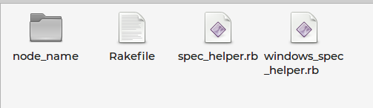
Intro to Serverspec
Directory with spec file(s) named as target node for multi node provisioning
Helper file spec_helper.rb with OS-specific configuration ssh, sudo, tempfile and sets the :backend to either :cmd, :exec, :ssh or :winrm. Usually helper files for Windows and unix are stored separately
Rakefile where path to every spec file passed to constructor of RSpec::Core::RakeTask
An rspec <filename> command is also possible (with the same effect)
and often used with Docker

Slide 16
Intro to Serverspec
The most basic spec are just a copy of the http://serverspec.org with only change in the subject name
context 'Basic' do
name = 'jenkins'
describe service(name) do
it { should be_enabled }
it { should be_running }
end
end
service {'jenkins':
ensure => running,
enable => true,
end
service 'jenkins' do
action [:enable, :start]
end

Slide 17
Where are practical expectations
The stock example would fit to validate the Jenkins module from Puppet Forge, but in practical scenario
one's expectations are more specific
context 'Jenkins Security' do
xmlfile = '/var/lib/jenkins/config.xml'
describe file(xmlfile) do
it { should exist }
its(:content) { should match '<useSecurity>false</useSecurity>'}
end
end

Slide 18
Exploring Serverspec
Having noticed that the 'file' method is backend run of a cat ‘run_command’ , and intending to processes XML in Ruby one would compose the test which does just that. Gets complex quickly
require 'rexml/document'
describe file(xmlfile) do
begin
content = Specinfra.backend.run_command("cat '#{xmlfile}'").stdout
begin
doc = Document.new(content); // ready for some DOM processing
result = true
rescue ParseException => e
result = false
end
rescue => e
result = false
end
it { result.should be_truthy }
end
https://github.com/mizzy/serverspec/blob/master/lib/serverspec/type/hadoop_config.rb

Slide 19
Exploring Serverspec
Running vendor command is the ultimate way to query app configuration, especially when provision is broken and focus on verifying too close to what Puppet is modifying could yield a false positive
context 'Mysql Datadir' do
custom_datadir = '/opt/mysql/var/lib/mysql/'
describe command(<<-EOF
mysql -sBEe 'select @@datadir;'
EOF
) do
its(:exit_status) {should eq 0 }
# implicitly confirm the mysql is running
its(:stdout) { should match custom_datadir }
end
end

Slide 20
Raise of custom Serverspec
One is basically interested in
application configuration files (JSON, XML)
systemd service details, various response headers to web requests,
open TCP ports, Unix socket and windows pipes
download artifact hashes
Jenkins fine level details of Jenkins job and pipeline configs
GAC and assemblies
Scheduled Tasks (Windows) and cron jobs (unix)
Puppet last run reports
As a result one has quickly growing collection. E.g. repo https://github.com/sergueik/serverspec_custom_types contains
100+100 snippets for each Linux and Windows.
https://github.com/mizzy/serverspec/blob/master/lib/serverspec/type/hadoop_config.rb

Slide 21

Serverspec implementation

Slide 22




Extreme serverspec
The engine responsible for the serverspec execution resembles that of Puppet or Chef: source is sent from developer to the target node to be eventually converted into target OS specific low level commands to execute - result is sent back to the developer. Unlike provision the serverspec is executed for its direct, not side effects. Both serverspec and Puppet has significant amount of code wrapping the actual command in some custom DSL, however a plain Exec/Command class is still available.
In the extreme case in the body of a Ruby spec Command, one could find a full source code of a java class that would be compiled and run in the target node to load and examine some cryptic JDBC, or ELK configuration changes applied in the course of node provision:

Slide 23
There isn’t any ‘spy’ facilities for server spec or unit test developments, neither are any in pure Ruby, Java or .Net, nor there is any ‘recording’ environment. To help new developers learn and quickly adopt to server spec follow clear Rspec/Cucumber semantics:
describe service(‘tomcat’) do
it {should be_running }
end
describe port(8443) do
it { should be_listening.with(‘tcp’) }
end
{'linux-kstat' => '0.1.3' }.each do |package_name, package_version|
describe package(package_name) do
it { should be_installed.by('gem')
.with_version(package_version) }
end
end

Slide 24
Soon with the growing number of detail the only two qualifying resources are the file and the command
context 'Virtual Host settings' do
describe file('/etc/httpd/conf.d/vhost.conf') do
[ 'ProxyRequests Off',
# multiple settings
].each do |line|
its(:content) { should match "^\s*" + Regexp.escape(line) }
end
end
end

Slide 25
Eventually the command is where the tricky part is:
Context ‘Security headers’ do
describe command('curl -k -I http://localhost') do
its(:stdout) { should match /Server: Apache\/\d\.\d+\.\d+ (:?Unix|CentOS)/i }
end
end
context 'Tomcat shutdown port' do
server_xml = "#{catalina_home}/conf/server.xml"
describe command(<<-EOF
xmllint --xpath "/Server[@shutdown='SHUTDOWN']/@port" #{server_xml}
EOF
) do
its(:exit_status) { should eq 0 }
its(:stdout) { should match 'port="-1"' }
end
end
https://tomcat.apache.org/tomcat-8.5-doc/appdev/web.xml.txt

Slide 26
Gradually the command itself could become tricky but reusable (Ruby or libxml2 used to focus on specific XML node):
describe 'redirect port 8080' do
doc = Document.new(content)
result = REXML::XPath.first(doc, "/Server/Service/Connector[@port = \"8080\"]/@redirectPort").value
it { result.should match '8443' }
end
context 'Tomcat servlet configuration' do
class_name = 'com.mycompany.mypackage.ControllerServlet'
describe command(<<-EOF
xmllint --xpath "//*[local-name()='servlet']/*[local-name()='servlet-class']/text()" #{web_xml}
EOF
) do
its(:stdout) { should match Regexp.new(class_name) }
end
https://tomcat.apache.org/tomcat-8.5-doc/appdev/web.xml.txt

Slide 27
Eventually the command is where the tricky part is (jq used to focus into the specific node of the JSON configuration):
context 'Consul service health check configuration' do
{
'myservice' => 'api/health'
}.each do |service, route|
describe command("jq '.service.checks[].http' < '/etc/consul.d/#{service}.json'") do
let(:path) { '/bin:/usr/bin:/usr/local/bin'}
its(:stdout) { should match( Regexp.new(
Regexp.escape("https://127.0.0.1:8443/#{route}"))) }
end
end
end
https://tomcat.apache.org/tomcat-8.5-doc/appdev/web.xml.txt

Slide 28
On Windows, Powershell and C# is used to retrieve obscure information about .Net
context 'specific assembly in GAC' do
assembly_name = 'WindowsFormsIntegration'
token = '31bf3856ad364e35'
describe command(<--EOF
$result = @()
[Object].Assembly.GetType('Microsoft.Win32.Fusion').GetMethod('ReadCache')
.Invoke($null, @([Collections.ArrayList]$result, '#{assembly_name}', [UInt32]2 ))
$result
EOF
)
do
its(:stdout) { should contain
"#{assembly_name}, Version=3.0.0.0, Culture=neutral, PublicKeyToken=#{token}" }
end
end

Slide 29
Serverspec usage for Puppet and Consul
A concise passing serverspec expectation may easily become a Puppet fact or an mco,knife/consul probe command
Facter.add('version') do
confine :kernel => 'windows'
script = "([xml](get-content -path 'version.xml')).Info.Product.version"
command = "powershell.exe -executionpolicy remotesigned -command \" & { #{script} }\""
result = Facter::Util::Resolution.exec(command)
end
consul exec https://$LEADER:$PORT rpm -q $PACKAGE \&\&
hostname -f | grep -A 1 $VERSION | grep -v $PACKAGE

Slide 30
A proper Serverspec expectation could replace native Ruby Puppet module fact which can be quite cryptic:
Facter.add('version') do
extend FFI::Library
ffi_lib 'version.dll'
attach_function :resource_size,:GetFileVersionInfoSizeA [:ptr, :ptr ], :int
attach_function :version, :GetFileVersionInfoA, [ :ptr,:int,:int,:buf_out], :int
version_information = '\VarFileInfo\Translation'.encode('UTF-16LE')
result = ' ' * (resource_size(filepath, nil))
status = version(filename, 0, size_in_bytes, result)
tmp = result.unpack('v*').map{ |s| s.chr if s < 256 } * ''
version_match = /FileVersion\s+\b([0-9.]+)\b/.match(tmp.gsub!(/\000/, ' '))
version_match[1].to_s
end

Slide 31
Serverspec expectation could be used for consul “script-kind” service check similar to /etc/consul.d/mongodb.json:
{
"service": {
"name": "mongo-db",
"tags": ["mongo"],
"address": "192.168.31.02",
"port": 27017,
"checks": [
{
"name": "Checking MongoDB"
"script": "/usr/bin/check_mongo.py --host 192.168.31.02 --port 27017",
"interval": "5s"
}
]
}
https://www.consul.io/docs/agent/checks.html

Slide 32
Making Java Application consul-ready
The http-kind service check heartbeat-response is provided by Spring after annotation is provided and dependency added to pom.xml:
@SpringBootApplication
@EnableDiscoveryClient
public class DiscoverableApplication {
public static void main(String[] args) {
SpringApplication.run(DiscoverableApplication.class, args);
}
}
<dependency>
<groupId>org.springframework.boot</groupId>
<artifactId>spring-boot-starter-actuator</artifactId>
</dependency>

Slide 33

Serverspec Integration challenges
https://tomcat.apache.org/tomcat-8.5-doc/appdev/web.xml.txt

Slide 34
Vagrant Serverspec provisoner
serverspec vagrant provisioner is part of the Vagrant flow, a little bit of disadvantage so its rake spec is from a deep stack of Ruby calls
elementary tasks like $DEBUG = ENV.fetch('DEBUG', false) become a bit problematic
serverspec is scheduled afterprovision and rerun is time consuming - not really when module is idempotent
with default settings error stack is super extra verbose
spec file (node_spec.rb) is not visible to therefore can not be produced by Puppet module - solvable through relative reference placing under files/serverspec/rhel/module_spec.rb and making the legacy one simply require_relative ‘../../files/serverspec/rhel/module_spec.rb’, with the actual path determined by workspace directory layout
assumes the availability of ssh between developer machine and target instance
which may change during secure environment provision
https://tomcat.apache.org/tomcat-8.5-doc/appdev/web.xml.txt

Slide 35
Serverspec through own Puppet module
serverspec being just a handful of text files plus a Ruby runtime – calls to be provisioned (rvm-hosted) through Puppet from archive and templates and an exec for rake spec on the instance then updates Puppet and Vagrant logs with the result. This remediates limitations
rake spec is directly in console and can be run explicitly after provision and the spec file edited in the instance. Debugging is easy.
Spec file is generated by Puppet from template, hieradata etc. for version-sensitive portion
(one can also keep serverspec require relative for Vagrant runs )
Runs on DMZ machine after lockdown, the results pushed to the developer, CICD etc.
A little cumbersome to modify file locally and push to the vm to validate
https://tomcat.apache.org/tomcat-8.5-doc/appdev/web.xml.txt

Slide 36
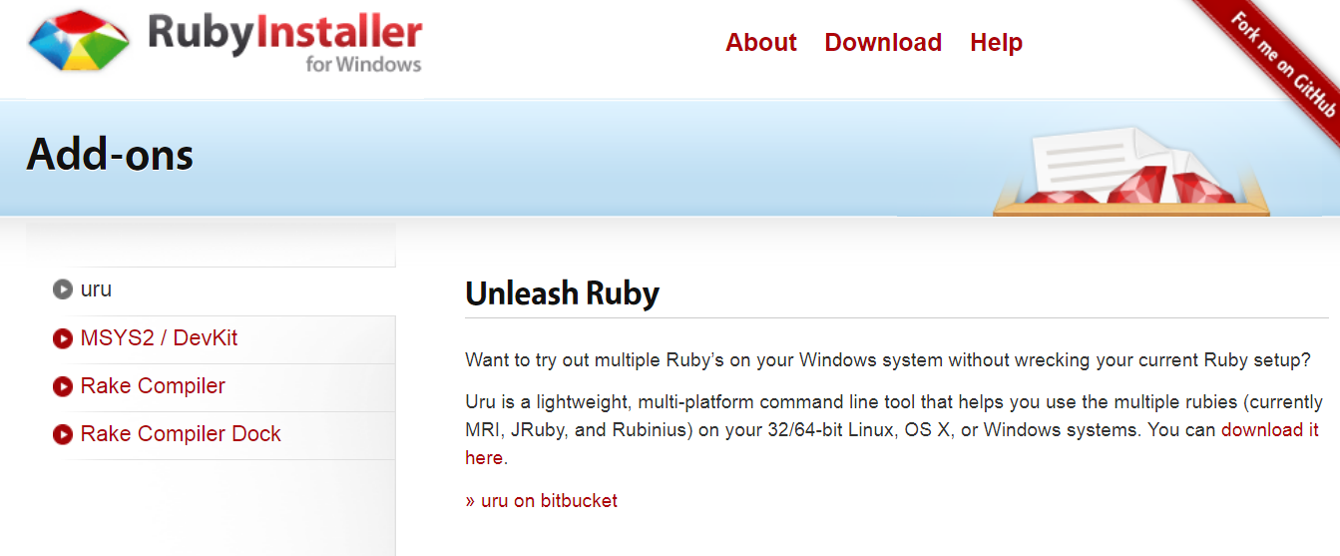
Serverspec through own Puppet module
https://rubyinstaller.org/

Slide 37
Serverspec through own Puppet module
hierarchy:
- name: 'Per-node data'
path: "node/%{::trusted.certname}.yaml"
- name: 'Per-role data'
path: "role/%{trusted.extensions.pp_role}.yaml"
- name: 'Shared data'
path: common.yaml
context 'Packages' do
{
consul => nil,
tomcat => '7.0.54-2',
jdk => '1.8.0.192'
}. each do |name,version|
describe package(name) do
it { should be_installed.with_version(version)}
end
end
end

Slide 38
Puppet-RSpec
Stubs target OS, environment facts, module parameters and hiera data
Compiles and examines the 'Catalog'
Asserts the specified actions are taken
All that without requiring one to spawn the real instance
Real provision will behave according to those specs
http://rspec-puppet.com
htps://github.com/chefspec/chefspec/tree/master/examples
Puppet Rspec is useful with
module and profile development and refactoring
intelligent upgrade / downgrade logic is critical (present|latest|absent)
with complex module logic or generation of complex configurations

Slide 39
Chef Spec
Performs the Puppet manifest / Chef cookbook compile check, allexceptions – will be also seen in real provision
Dumps catalog through one of few available methods:
describe ‘module’ do
it { should compile.with_all_deps}
at_exit { RSPec::Puppet::Coverage.report! }
it { p catalogue.resource}
end
no example for Chef

Slide 40
Chef Spec
Stubs target platform, ohai, cookbook attributes
Performs ‘Converge’ and examines the catalog, asserts specified actions are taken
require 'chefspec'
require 'json'
describe 'selenium_hub::default' do
let(:chef_run) { ChefSpec::SoloRunner.converge(described_recipe) }
it 'creates selenium directory' do
expect(chef_run).to create_directory('/opt/selenium')
end
it 'starts selenium hub service' do
expect(chef_run).to start_service('selenium_hub')
end
continued on the following slide

Slide 41
Chef Spec
Popular practice during module / cookbook development to run rspec to examine and fine tune resources produced from template, saving on a real Puppet / Chef run
describe 'selenium_hub::default' do
let(:chef_run) { ChefSpec::SoloRunner.converge(described_recipe) }
it 'generates init script configuration' do
expect(chef_run).to render_file('/etc/init.d/selenium_hub')
end
it 'generates a valid json configuration' do
expect(chef_run).to render_file('/opt/selenium/node.json')
.with_content( satisfy do |content|
JSON.parse(content) rescue nil
end
)
end
end

Slide 42
Puppet “defines” Spec
The Ruby DSL syntax is quite divergent
require 'spec_helper'
describe 'logrotate::cron' do
# NOTE: verbatim Puppet code
let(:pre_condition) { 'class { "::logrotate": }' }
context 'with default params' do
let(:title) { 'test' }
let(:params) { { ensure: 'present' } }
it {
is_expected.to
contain_file('/etc/cron.test/logrotate').with_ensure('present')
.with_content(
%r|'/usr/sbin/logrotate /etc/logrotate.conf 2>&1'|)
}
end
end
https://github.com/voxpupuli/puppet-logrotate

Slide 43
Chef Resource Relationship Spec
The Ruby DSL offers advanced ‘relationship’ expectation API, which unfortunately are not to be fully relied upon
it do
should contain_file('c:/temp/log')
.with(ensure => 'directory'
.that_requires('c:/temp')
.that_comes_before('Acl[c:/temp/log]')
end
it 'notifies service' do
resource = chef_run.file(@setenv_file)
expect(resource).to_not
notify("service['#{@application_server}']").to(:restart).delayed
end

Slide 44
Chef Resource Relationship Spec
Overall with very few exceptions Rspec is valuable to module developer only. These specific scenarios include:
Module so flexible it is impractical to test all combination every supported configuration. E.g. logrotate that is a good example
https://github.com/rodjek/puppet-logrotate/blob/master/spec/defines/rule_spec.rb-1100 + lines very granular.
Puppet module like puppetlabs-apache which managing something that is probably more complex, in many ways, than Puppet itself. Thus module also has 2000+ lines in some rspec
https://github.com/puppetlabs/puppetlabs-apache/blob/master/spec/defines/vhost_spec.rb
and also has equailly big acceptance tests focusing on security, ssl, cgi, vhosts etc.
https://github.com/puppetlabs/puppetlabs-apache/tree/master/spec/acceptance
with 1700 lines of
https://github.com/puppetlabs/puppetlabs-apache/blob/master/spec/acceptance/vhost_spec.rb
In this case, some configurations are not meaningful or valid from apache standpoint and to request means force the provision fail.

Slide 45
Puppet Beaker Integration testing tool
Recently, used Beaker wraps Vagrant(Docker) and Serverspec to provision the instance(s), iterating over supported target platforms, often performing multiple consecutive puppet agent runs, and inspects the catalog compilation status and examines catalogs, focusing on reboots, idempotency (by ensring no resources are modified in the second run).
Taking somewhat Rails-like metaprogramming style in defining boilerplate reusable but vague expectations
require 'spec_helper_acceptance'
it 'should run with no errors applying all changes in the first run' do
apply_manifest(<<-EOF
include stdlib
EOF
,
:modulepath => '/etc/puppetlabs/code/modules',
:debug => true,
:catch_failures => true).exit_code).to eq 2 # be_zero
end
https://www.rubydoc.info/gems/beaker/2.4.1/Beaker/DSL/Helpers

Slide 46
Questions?

Slide 47

Thank You

